Slide 1

September 2022
Marketing analysis of e-commerce data
Chyavan M Chandrashekar
Prathyusha Vedulla
Rochan Nehete
Sai Bhargav Tetali
Shubhada Kapre

Slide 2
Objectives of Project
To perform a Market-Basket Analysis of products of the retailer
To segment customers based on purchase history
To perform RFM analysis to determine most profitable customers

Slide 3
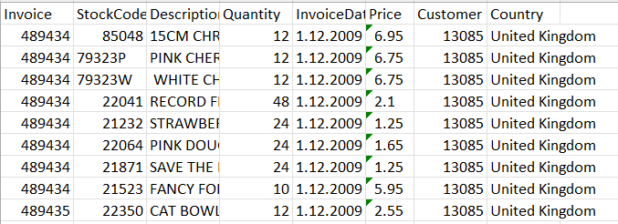
Dataset
Column | Description | Comment
InvoiceNo | Invoice number | A 6-digit integral number uniquely assigned to each transaction. If this code starts with the letter 'c', it indicates a cancellation
StockCode | Product code | A 5-digit integral number uniquely assigned to each distinct product
Description | Product name
Quantity | The quantities of each product per transaction
InvoiceDate | Invoice date and time | The day and time when a transaction was generated
UnitPrice | Unit price | Product price per unit in sterling (£)
CustomerID | Customer number | A 5-digit integral number uniquely assigned to each customer
Country | Country name | The name of the country where a customer resides
1M rows
2-year dataset from Dec 2009 to Dec 2011
52961 invoices, 862 customers, 5576 products

